Slide 1
User Stories
P1 items
Create Trip → Enter title, start & end date or duration, Address with Map below it & Save → Trip details page → add existing photos/memos to the trip.
See trip in the list → Build / Edit / Delete Operations → Upcoming & Past in a Tab view (2)
View Trip details → See Photos, Memos & Location on Map With places visited.
Add a Photo : 1. Select an existing trip and then take a photo or add existing photo → Camera button is within the app.
3. Take a photo and based on the location & time, we add it automatically to the trip → then it works with camera app or the camera icon within the app (placement ?)

Slide 2
P2 - User stories
P2 items
Voice Notes : Similar to Add Photo (based on location, time or existing trip)
Edit trip : Delete Photo/Memo/VoiceNotes, Change Title/other details .
Delete Trip : delete only the trip info but keep the Photos/Voice Notes etc
Showing POI on map&listview : 1. View trip details → Open Map view → POIs near you or the address entered
2. Launch App → Open Map view → POIs near you or the address entered.
3. How do we view places we visited in the past ?

Slide 3
P3 - User stories
P3:
Share memo with friends:
Facebook login/Twitter login
List & Find friends
Public or private Trip
Share → Select a public trip → Select a friend → Send trip link to Facebook Wall/Messenger → Deeplinking the share
View a shared Trip : Open the link → Opens up our app (if installed)
View public trip by friends
Profile/Settings
Authentication with FB/Twitter/Google/Email
Fetch user profile from FB/Twitter/G+ or Create a local profile
Settings :

Slide 4
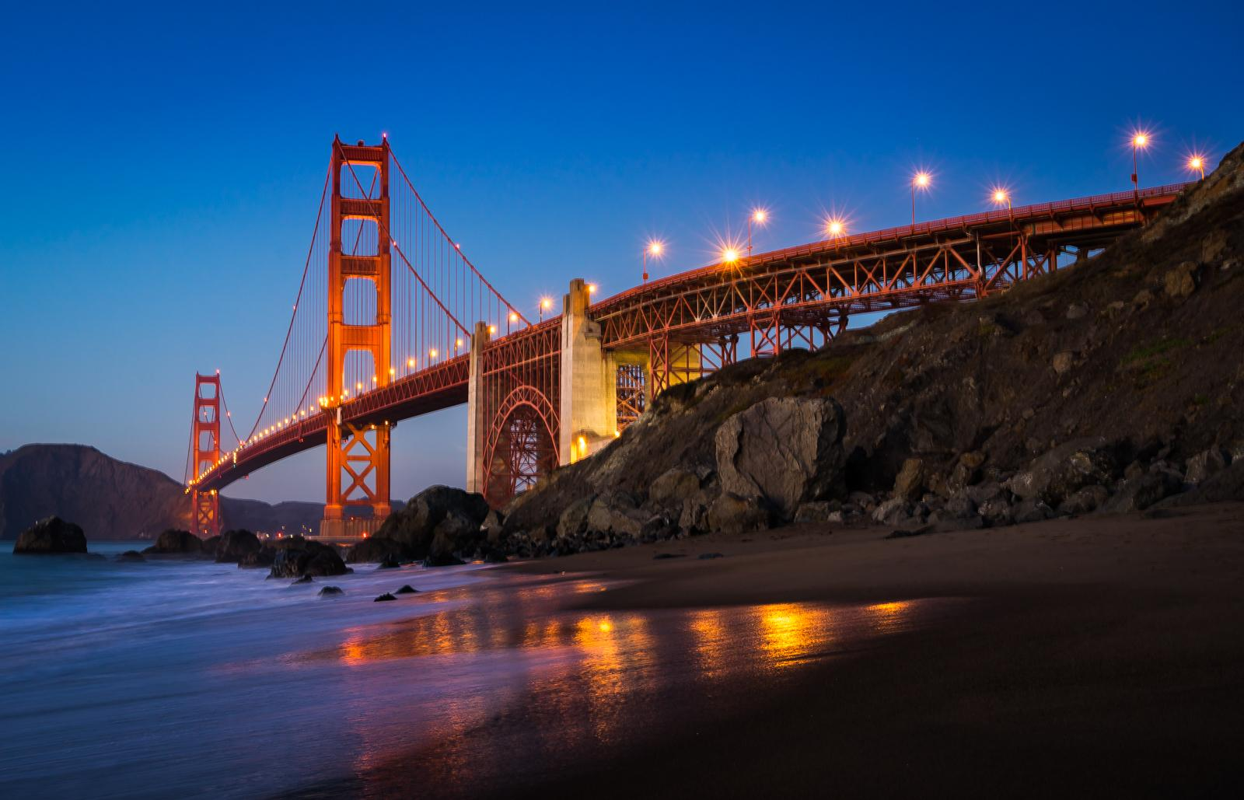
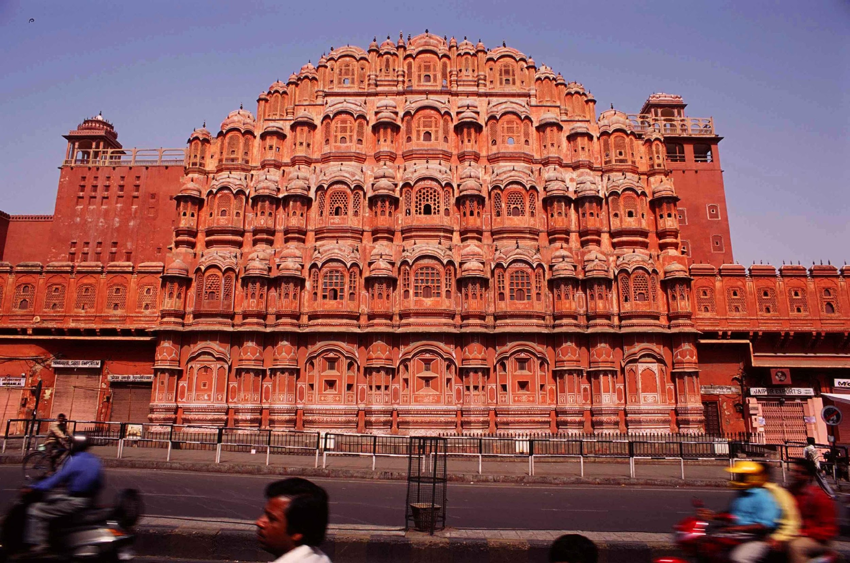
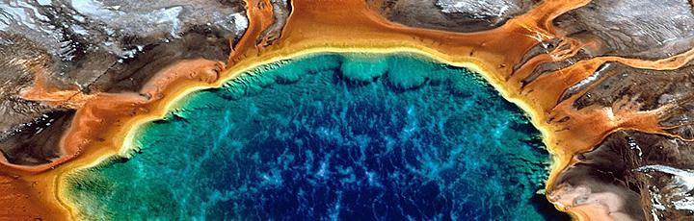
Create Trip
Upcoming
Upcoming
Upcoming
Travel Memo
Travel Memo
Create trip
Upcoming
Upcoming
Trip Name
(Card
View)
Trip Description
Start date
Completed
Duration
San Francisco
7th Sept 2016
Details about San francisco
No Photos. Tap to add
photos to your trip
Completed
+
+

Slide 5
Create Trip
Upcoming
Upcoming
Create trip
Upcoming
Create trip
Create trip
Save
The
trip
Trip Name
Australia
Melbourne Aiport,
Melbourne
Please enter a trip name
Trip Description
Melbourne, Perth & NZ
Map View
Showing the address for the trip
Start date
10th Nov 2016
Duration
Duration
No Photos. Tap to add
photos to your trip
No Photos. Tap to add
photos to your trip

Slide 6
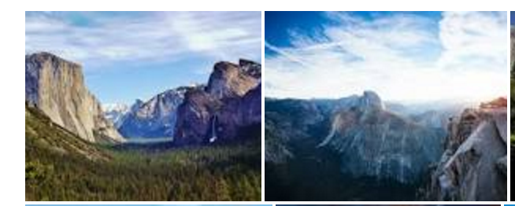
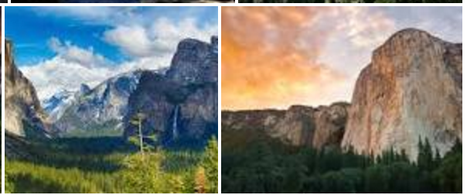
Create Trip
Upcoming
Create trip
Add photos
Upcoming
Upcoming
Create trip
Yosemite
Yosemite
Half dome hike
Half dome hike
10th Jun2016
10th Jun2016
This trip occurred in the past
This trip occurred in the past
Duration
Duration
No Photos. Tap to add
photos to your trip
Via Share

Slide 7
Create Trip ( Carousal View )
Upcoming
Travel Memo
Travel Memo
Upcoming
San Francisco
Upcoming
Jaipur
Completed
20th Aug - 30th Aug
20th May - 30th May
Trip to Jaipur where we visited famous palaces, local shops and temples. Lots of street food. Very Hot in summer
+
+

Slide 8
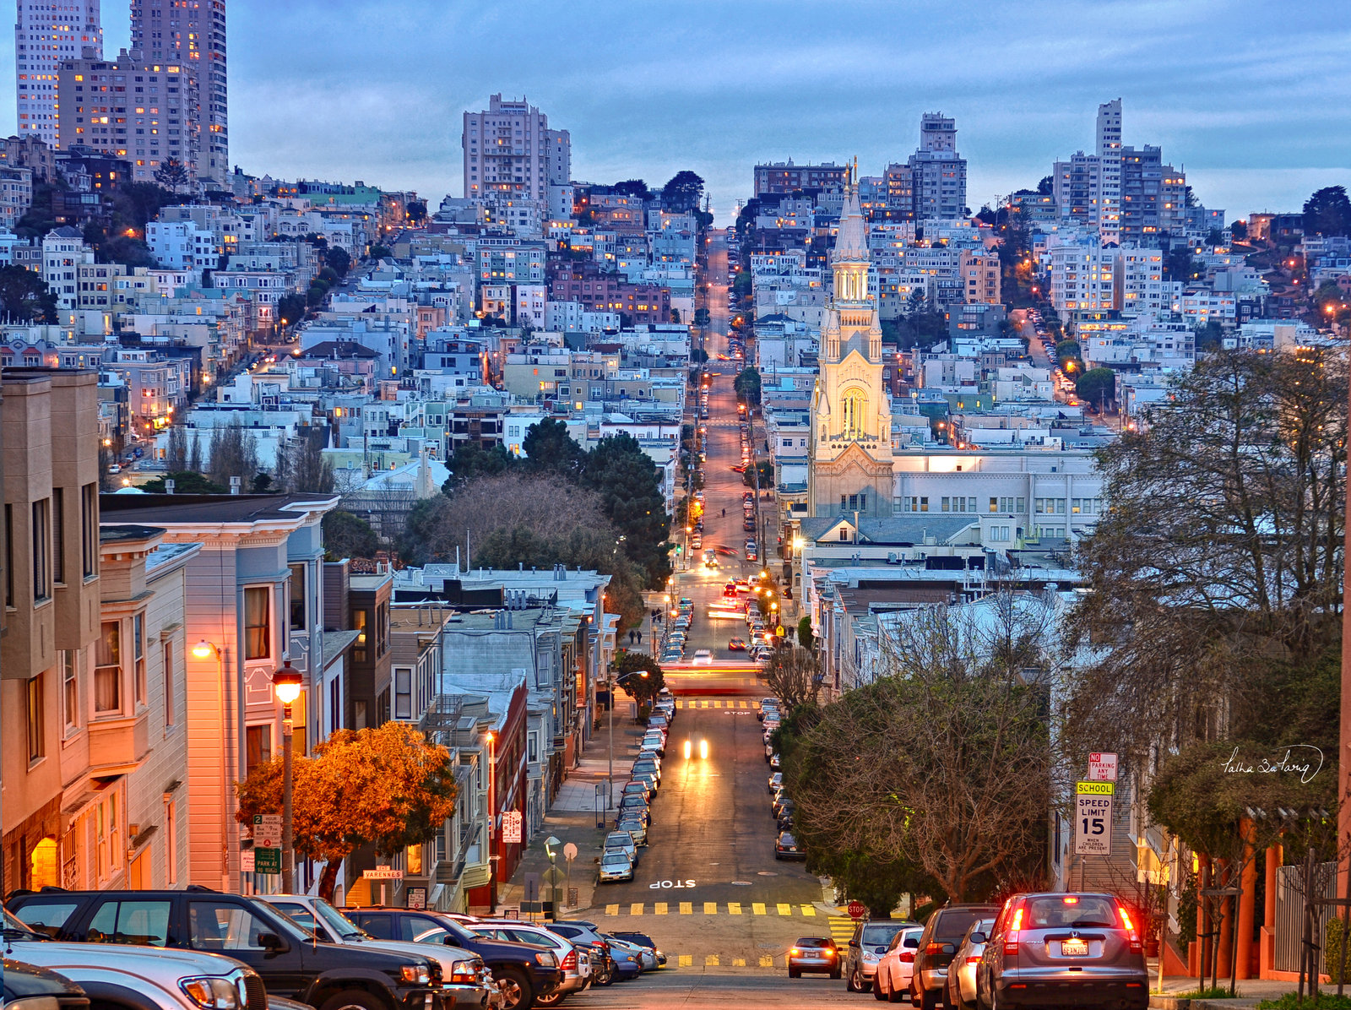


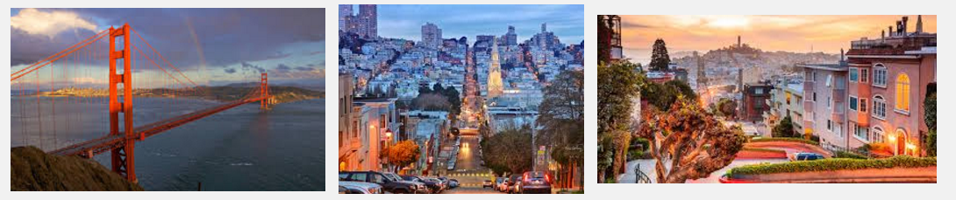
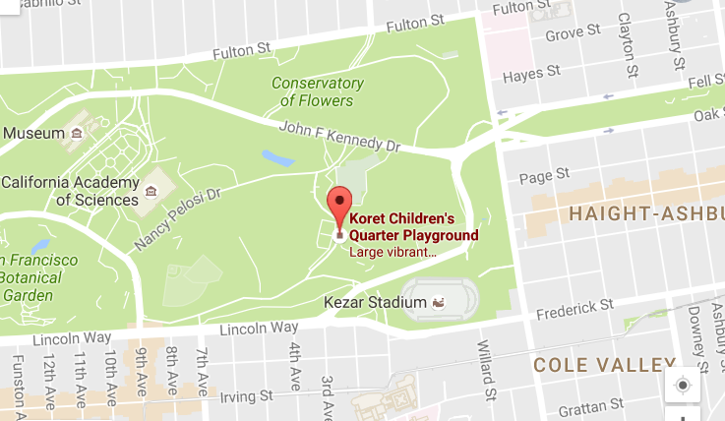
Detail of a trip 1/2
Upcoming
Family Trip to SF
Family Trip to SF
Travel Memo
Upcoming
Family Trip to SF
08/20/2016 - 08/30/2016
Click a image
San Francisco, in northern California, is a city on the tip of a peninsula surrounded by the Pacific Ocean and San Francisco Bay.
This is description of the trip user enter.
a photo clicked
Member
Add a member ( twitter screen name to show profile image otherwise, show first letter of name
Completed
Photos
Location : San Francisco, CA
+
+
Add more photo to this trip with this button (Show add photo flow)

Slide 9
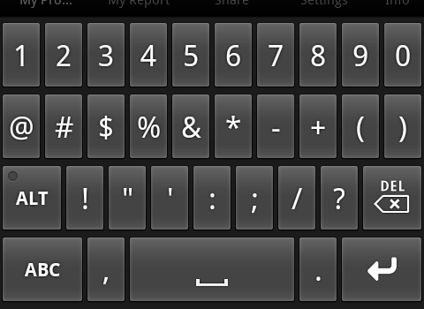
Detail of a trip 2/2 - Add a trip member
Family Trip to SF
Family Trip to SF
Family Trip to SF
Family Trip to SF
08/20/2016 - 08/30/2016
Add a member
08/20/2016 - 08/30/2016
San Francisco, in northern California, is a city on the tip of a peninsula surrounded by the Pacific Ocean and San Francisco Bay.
This is description of the trip user enter.
San Francisco, in northern California, is a city on the tip of a peninsula surrounded by the Pacific Ocean and San Francisco Bay.
This is description of the trip user enter.
Member
Member
ADD
Photos
Photos
Location : San Francisco, CA
Location : San Francisco, CA
+
+

Slide 10
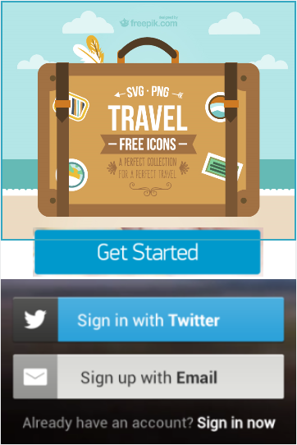
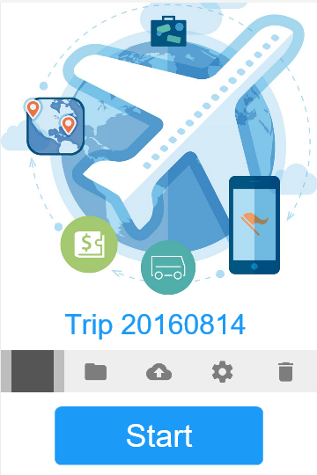
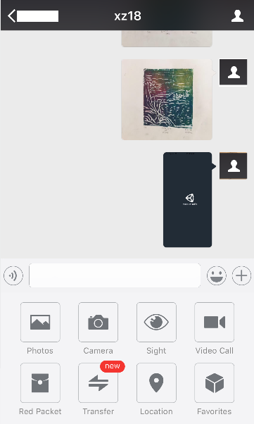
Login Page
Create a new trip
Use the setting buttons to modify trip details
Chat dialog to insert trip Media and Memo. It’s easy for multi-user real time use. the Timeline is automated organized here.

